Slide 1

# Project 2
Ames Housing Data and Kaggle Challenge
Presented by: Aw Boon Jun

Slide 2
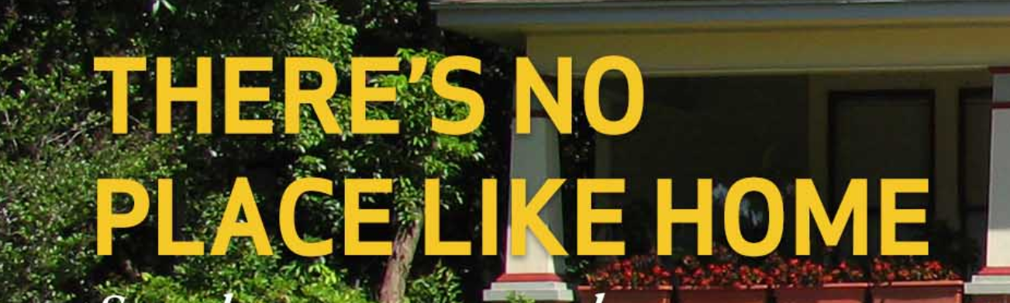
Ames is a city in Story County, Iowa, United States approximately 30 miles north of Des Moines in central Iowa. It is best known as the home of Iowa State University, with leading Agriculture, Design, Engineering, and Veterinary Medicine colleges.
INTRODUCTION
In this project, datasets obtains from the Ames Assessor’s Office (through Kaggle) are used to create a regression model that predicts the price of houses in Ames, IA.

Slide 3
PROBLEM
STATEMENT
To build a regression model with the
lowest error
to predict Sales Price of houses sold in Ames

Slide 4
Data set contains information from the Ames Assessor’s Office used in computing assessed values for individual residential properties sold in Ames, IA from 2006 to 2010.
Source: https://www.kaggle.com/c/dsi-us-6-project-2-regression-challenge/
DATASETS
2051
81
Train.csv
Observations
variables
879
80
Test.csv
Observations
variables

Slide 5
23
21
20
17
Train.csv
Ordinal
Nominal
Continuous
Discrete
For model selection & fitting
DATASETS
23
21
19
17
Test.csv
Ordinal
Nominal
Continuous
Discrete
For prediction of house price to submit to Kaggle

Slide 6



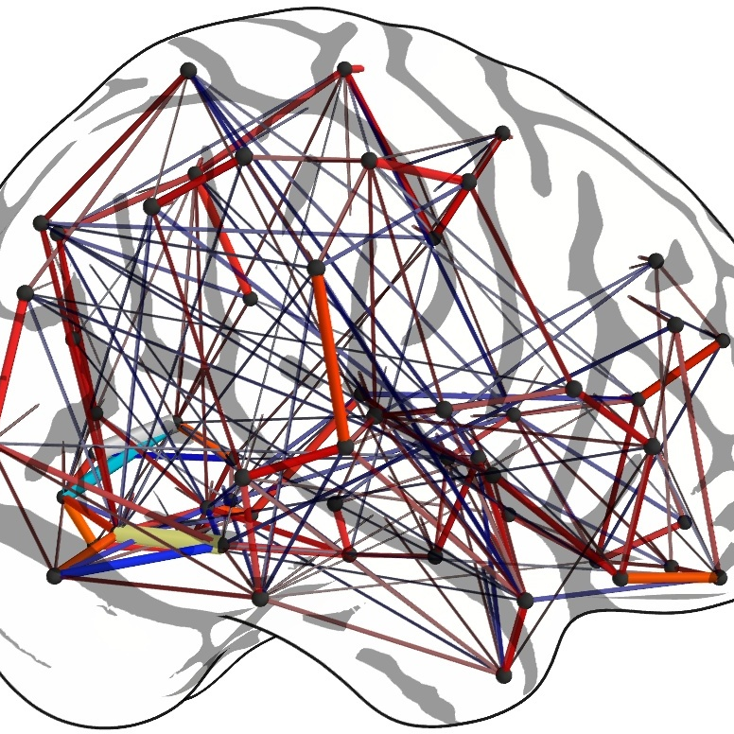
WORKFLOW
Data Cleaning
One-Hot Encoding
Feature Engineering
Modeling & Prediction
Null handling
Combine/remove
Outlier removal
EDA
Encode category variable
Ensure same shape for Train & Test
Lasso Selection
30 variables
4 model: LR, Lasso, Ridge, Elastic
Predict with LR

Slide 7
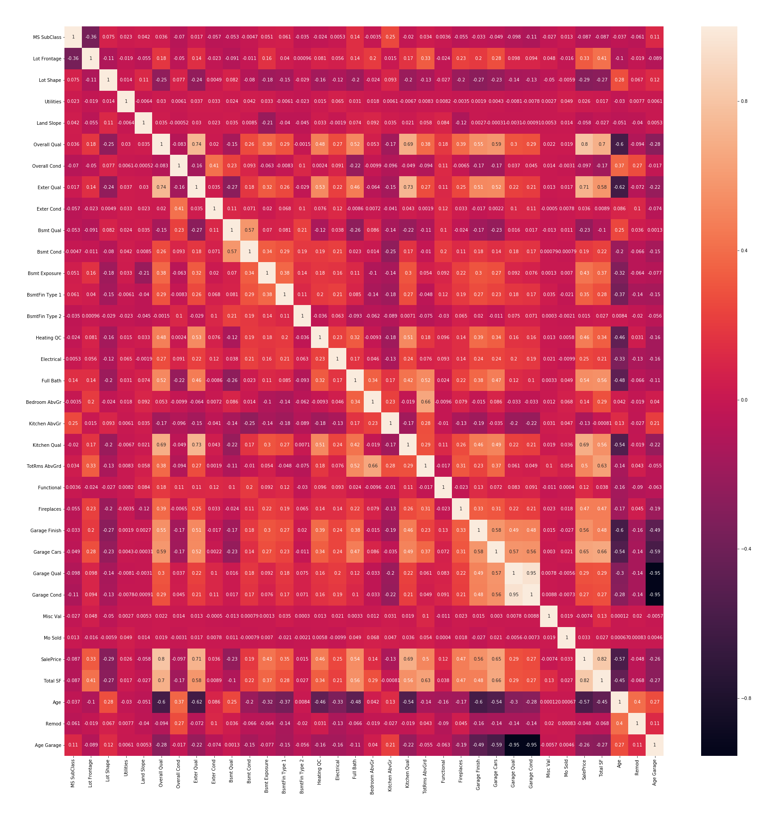
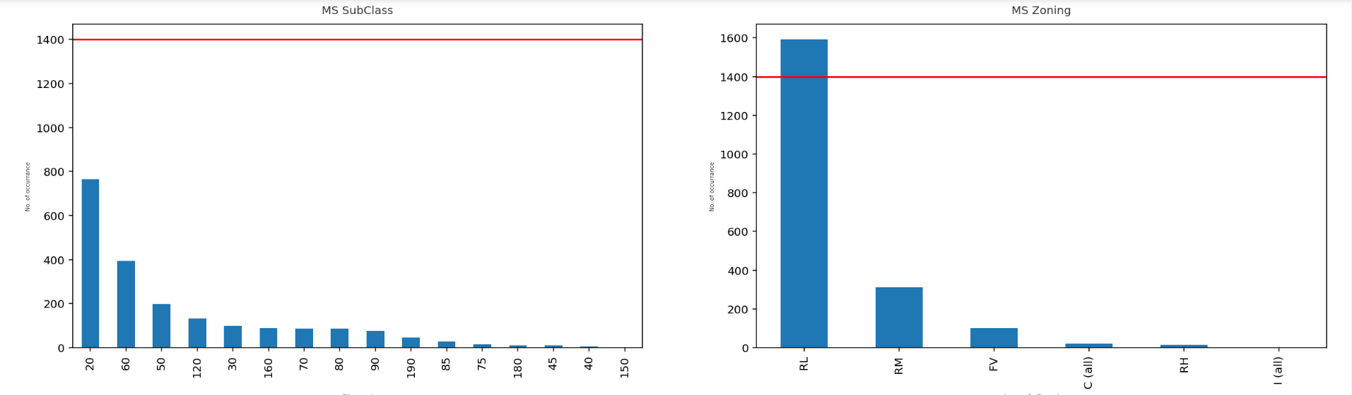
EDA
Plotting distribution histogram to eliminate skewed distributed variables
Correlation heatmap to eliminate variables

Slide 8
WORKFLOW
Data Cleaning
One-Hot Encoding
Feature Engineering
Modeling & Prediction
Null handling
Combine/remove
Outlier removal
EDA
Encode category variable
Ensure same shape for Train & Test
Lasso Selection
30 variables
4 model: LR, Lasso, Ridge, Elastic
Predict with LR

Slide 9
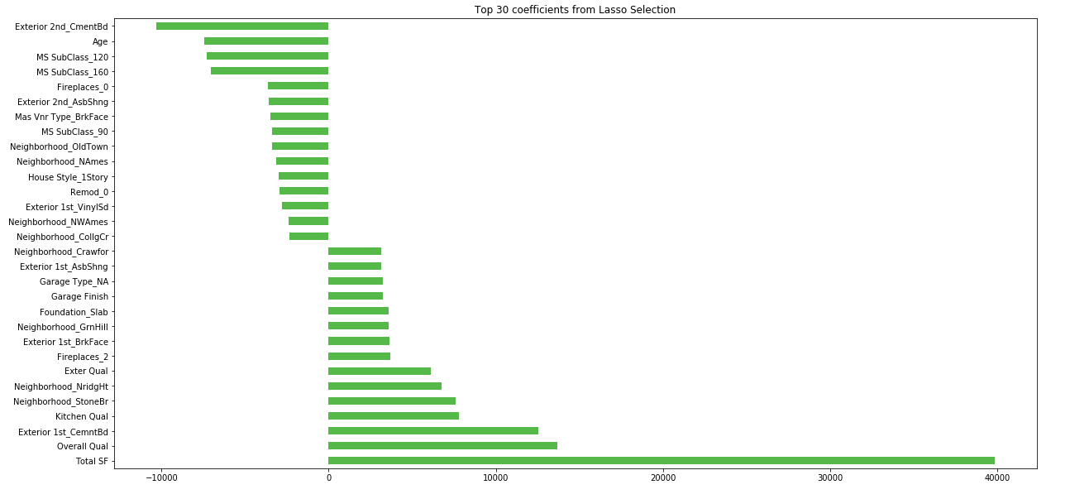
FEATURES ENGINEERING
Using Lasso to select top 15 +ve & -ve coefficients as final variables for model selection

Slide 10
WORKFLOW
Data Cleaning
One-Hot Encoding
Feature Engineering
Modeling & Prediction
Null handling
Combine/remove
Outlier removal
EDA
Encode category variable
Ensure same shape for Train & Test
Lasso Selection
30 variables
4 model: LR, Lasso, Ridge, Elastic
Predict with LR

Slide 11
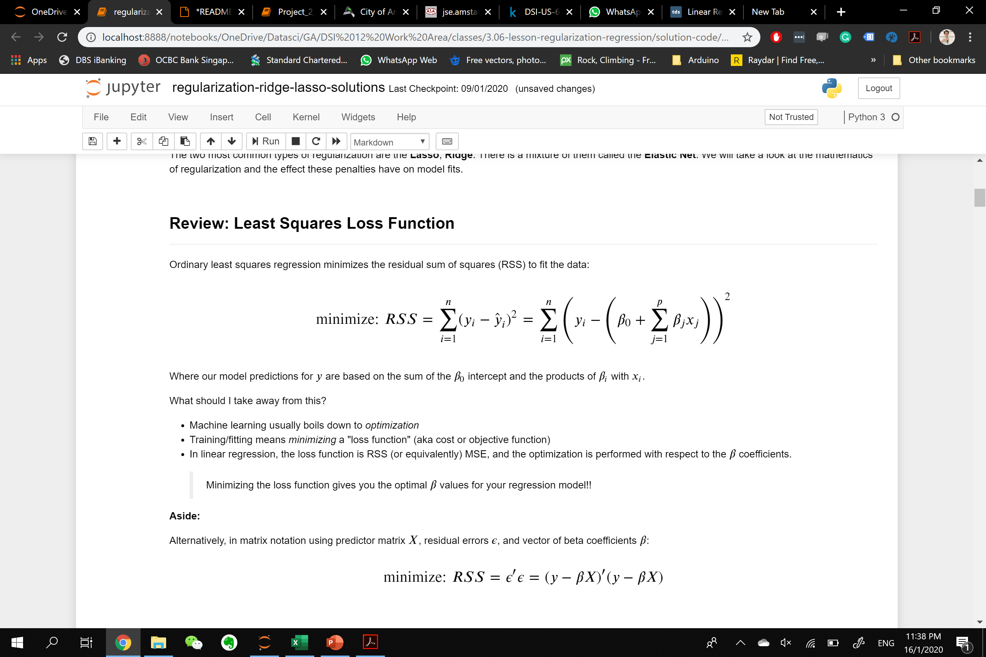
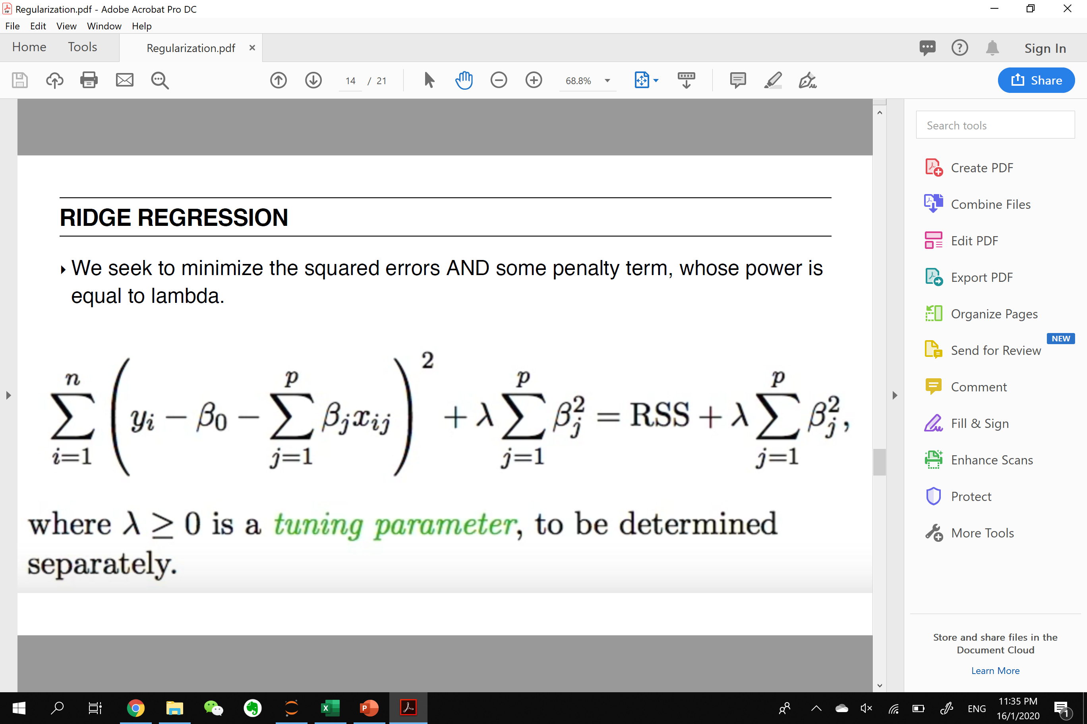
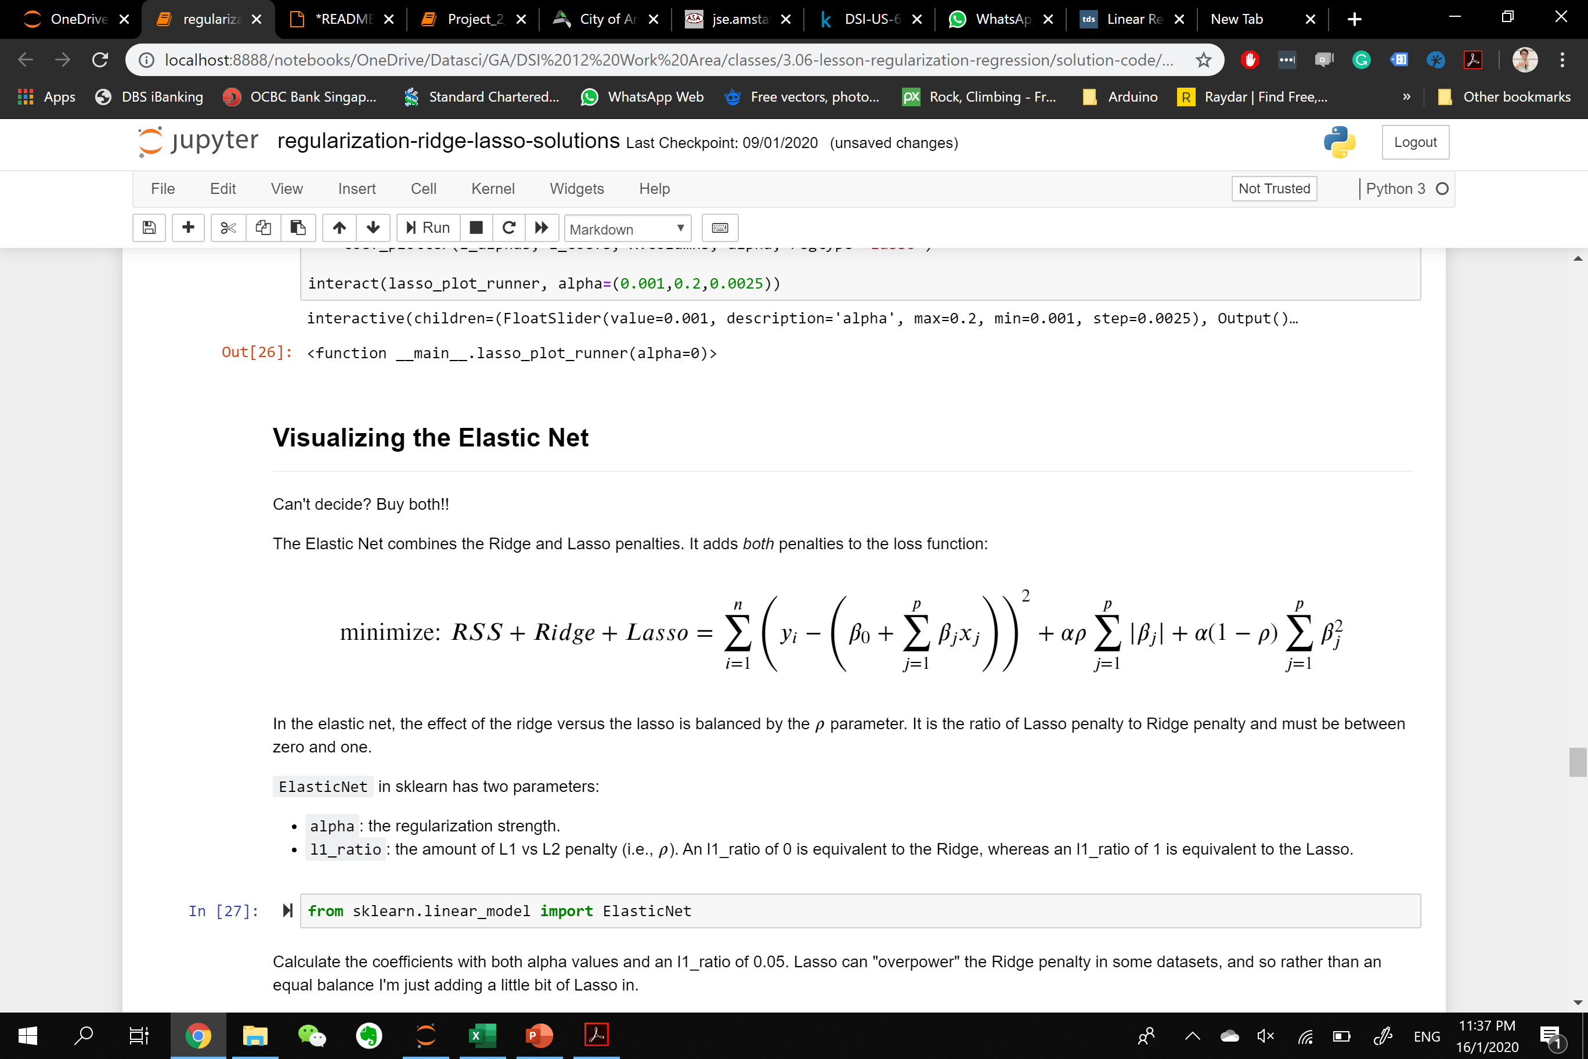
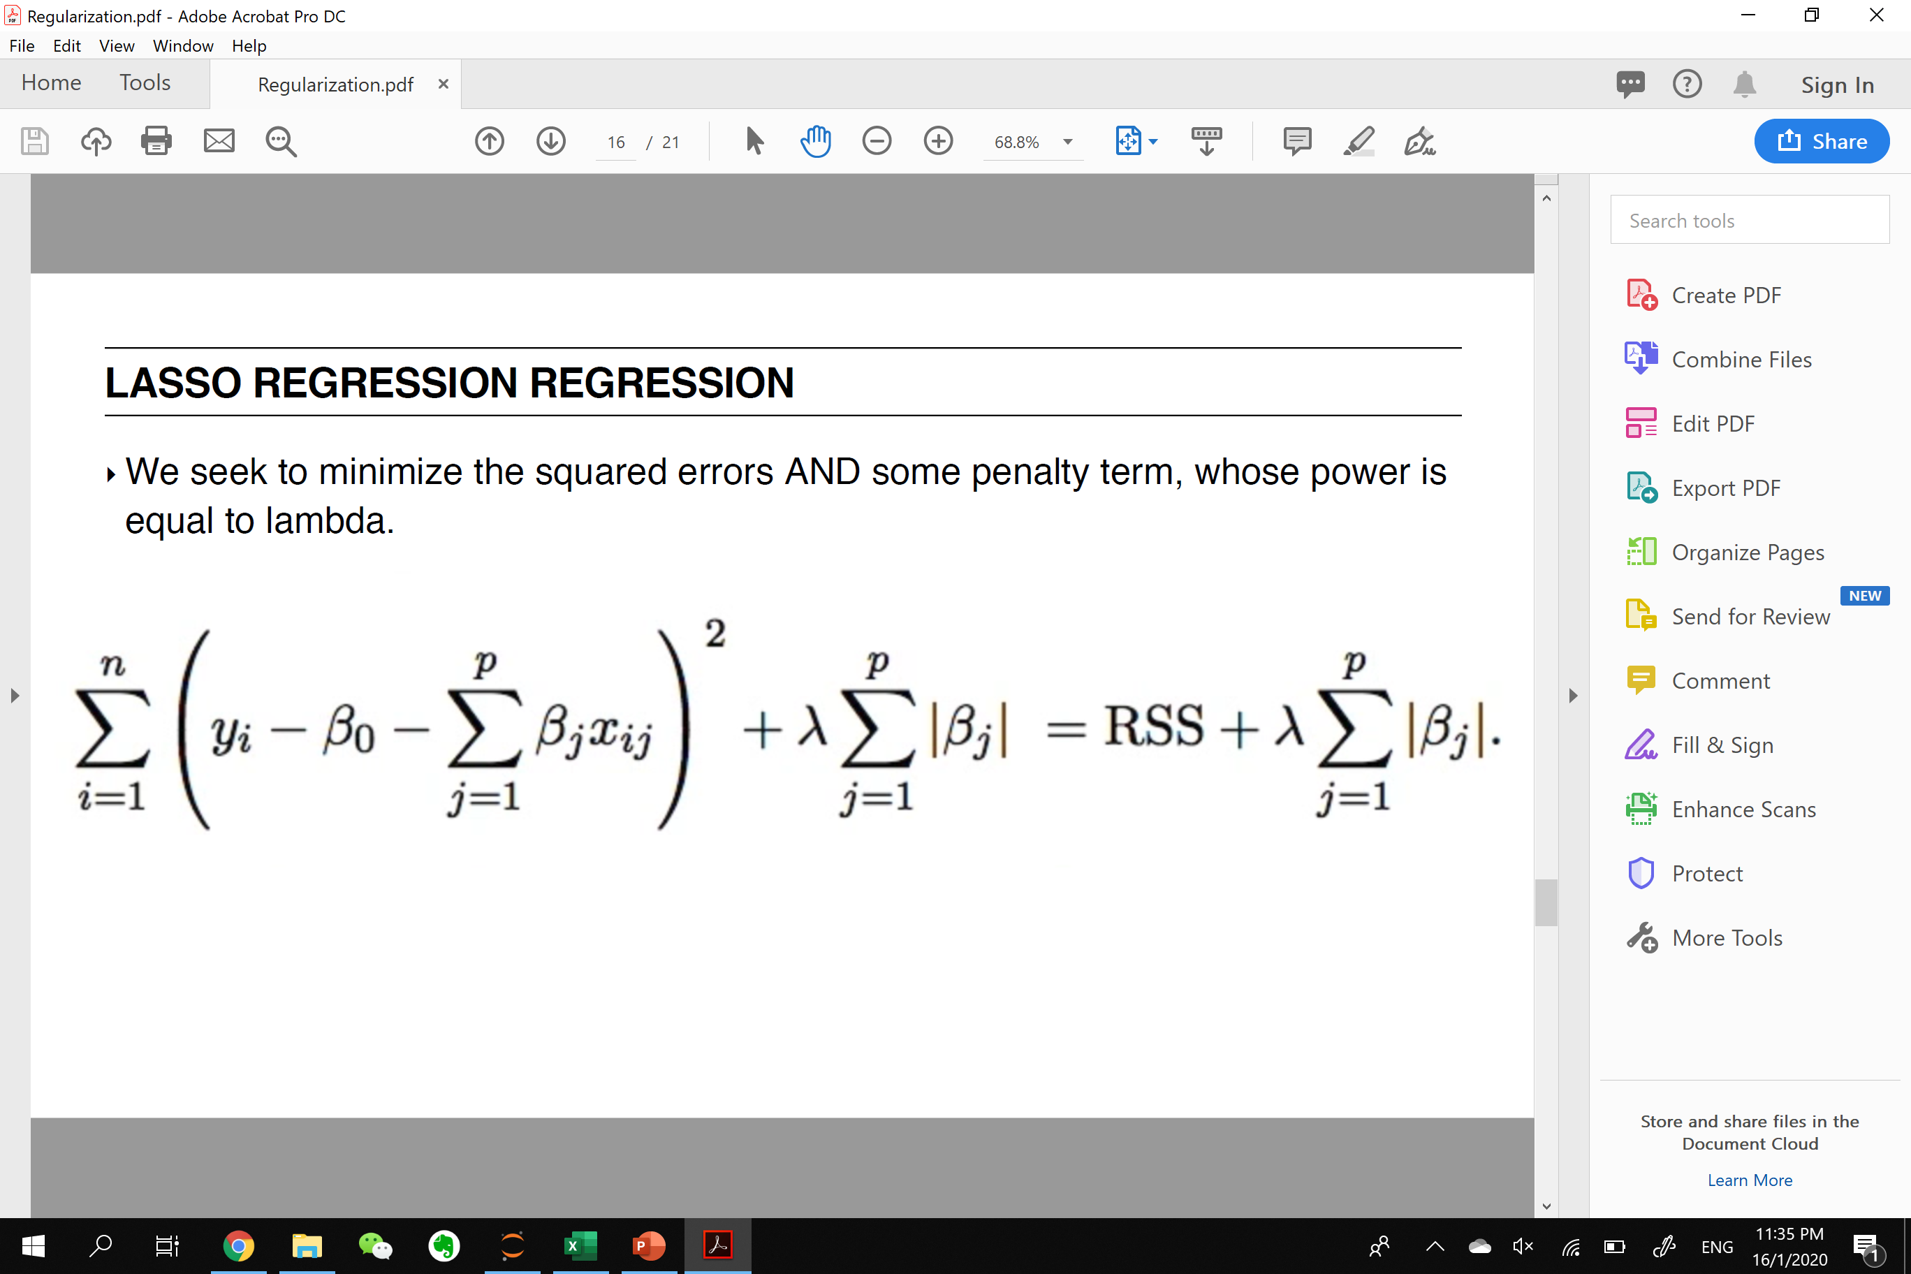
MODEL SELECTION
Linear Regression
Ridge
Elastic Net
Lasso

Slide 12
MODEL SELECTION
Train/Test Split: 0.25 test size
Validation of model by comparing scores of 4 models
Select Linear Regression and fit X, y (Before split data)
Predict with test data set
Model | R2 Score
Linear Regression | 0.8852429133130981
Ridge | 0.8851807633561328
Lasso | 0.8852429122211832
Elastic Net | 0.8727541829079618

Slide 13
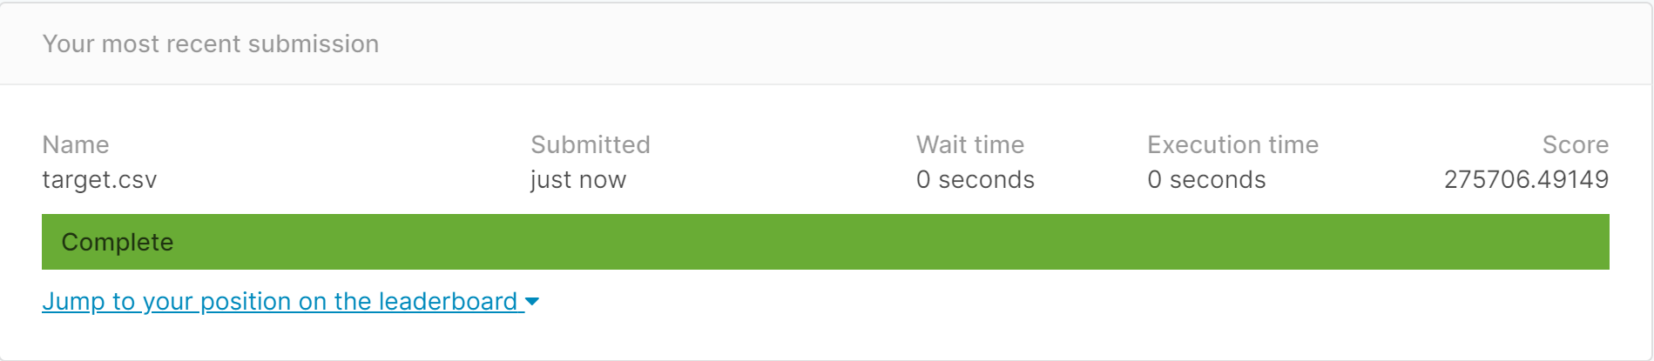
PREDICTION WITH LR
R2 Score | 0.8871977269985987

Slide 14
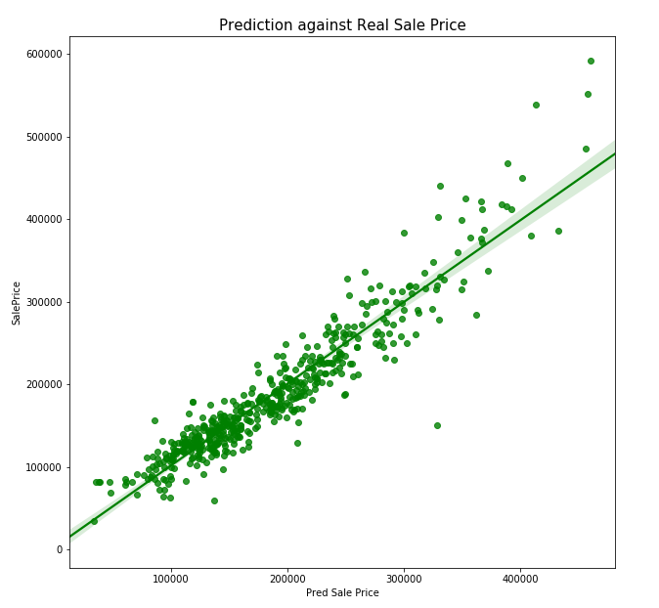
SUMMARY
Model | R2 Score
Linear Regression | 0.8852429133130981
Lasso | 0.8852429122211832
Small differences in R2 score with lasso = model is not over-fitted
Covers 88.5% of the dataset

Slide 15
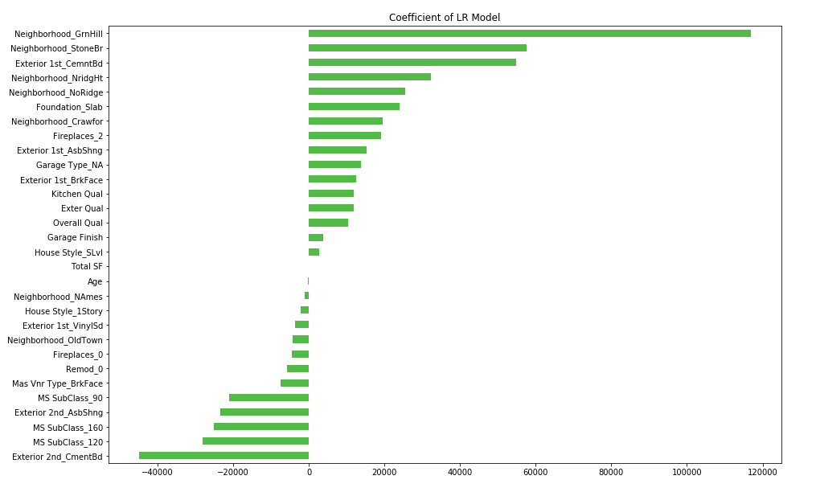
SUMMARY
Being in the neighborhood Green Hills will increase the Sale Price by USD 16,899
Total Square Feet & Age of House will not affect house sale price as much
Green Hills, Stone Bridge, North Ridge Height, North Ridge neighborhood houses affect sale prices the most among others in Ames
Planned Unit Development (PUD) houses will decrease the sale price (MS SubClass 160 & 120)

Slide 16
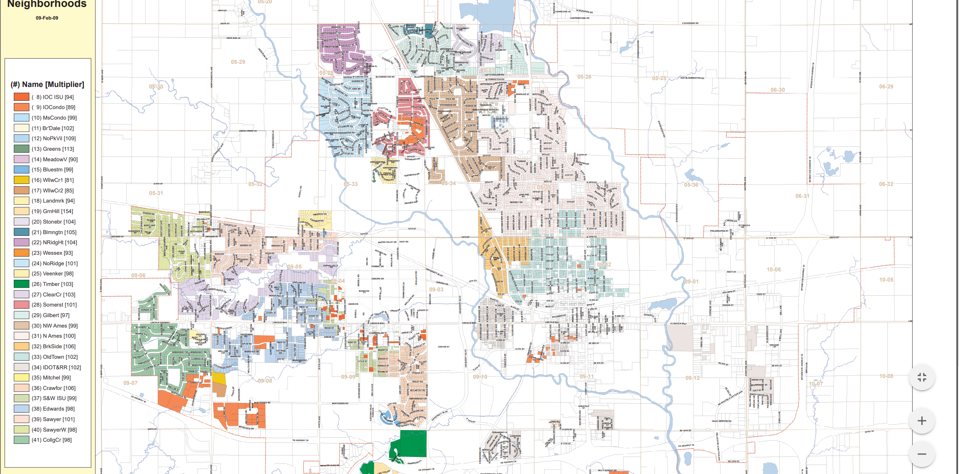
SUMMARY
Green Hills close to Iowa University
North Ridge, North Ridge Height and Stone Bridge are in upper class neighborhood
North Ridge
Height
Stone Bridge
North Ridge
City Center
Green Hills

Slide 17
THANK YOU

